Slide 1
Five Project Management Process Groups
Christopher Paez, Chang Woo Shin, Israa Jeddeeni

Slide 2
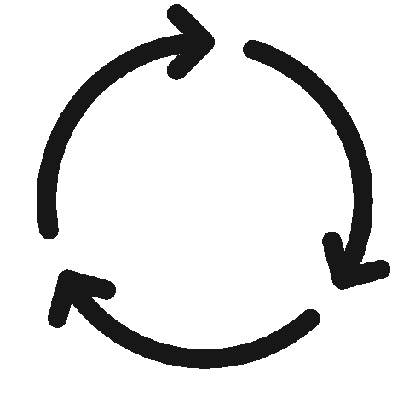
Project Life Cycle
Complex projects that are far-reaching in scope, resource-heavy, and are high in strategic importance will require higher levels of project management knowledge. Having a basic understanding of the project life cycle and the 5 phases of project management will help project managers achieve consistent and repeatable project success.

Slide 3
What is the project life cycle?
The project life cycle includes the steps required for project managers to successfully manage a project from start to finish. There are 5 phases to the project life cycle (also called the 5 process groups). Each of these project phases represents a group of interrelated processes that must take place.

Slide 4
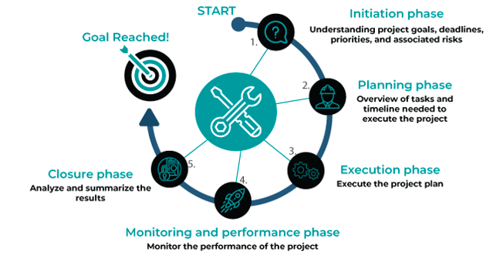
The 5 process groups of project management

Slide 5
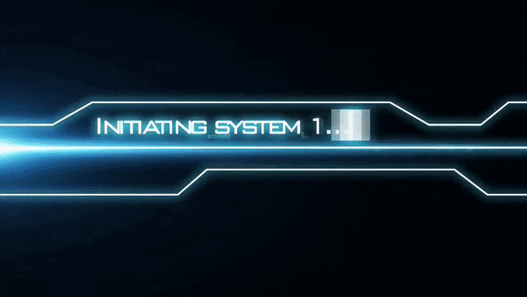
Initiating
The initiating phase of the project life cycle consists of just two separate processes: the project charter and stakeholder register.
The point of this phase is to determine the vision for your project, document what you hope to accomplish, and secure approvals from a sanctioning stakeholder.

Slide 6
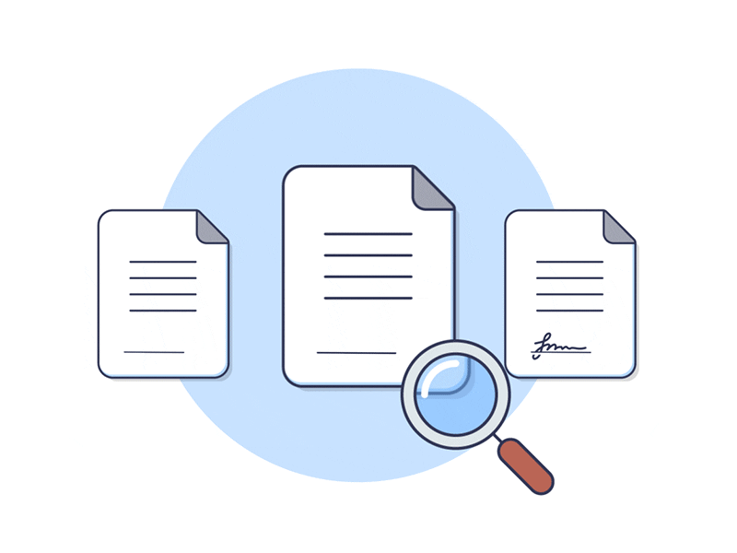

What is a project charter?
A project charter is a short, straightforward document that serves as the foundation for a project.
The project charter functions as both the project’s internal marketing tool and reference guide.

Slide 7
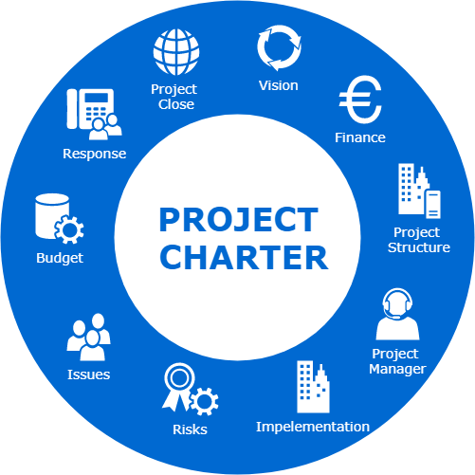
What’s included in a project charter?
Business case
Project scope
Deliverables
Objectives
Resources needed
Milestone plan and timeline
Cost estimate
Risks and issues
Dependencies

Slide 8

What is a Stakeholder Register?
A stakeholder register is a project document with pertinent information about the project stakeholders.
It identifies the people, groups, and organizations that have any interest in the project or its outcome.

Slide 9
A stakeholder register can have the following information of stakeholders
Names | Titles | Roles | Interests | Power | Requirements | Expectations | Type of influence
Alex | Project Manager | Project director | High | High | Weekly Report | Proven Data with numbers | High
Judy | IT Manager | IT director | Medium | Low | Monthly Report | New IT system | High
James | HR Manager | HR Director | Low | High | Weekly Report | More employers | Medium

Slide 10

Planning
Establishing the project's overall scope is an important part of the planning process.
While it may appear that scope (together with risks, milestones, summary, and budget) was specified at a high level in Initiating, it was not.

Slide 11
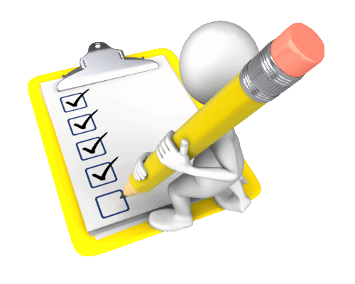
Planning cont.
The planning phase process group is where you build the project infrastructure that will enable you to achieve your goal within your predetermined time and budget constraints.
The planning stage includes; starting with a project management plan, project scope, work breakdown structure and more—and wrapping up with qualitative and quantitative risk analyses and risk responses.

Slide 12

Executing
This is the process where the work will get done and takes the most resources to perform the process.
It is in this area of Executing that most of the budget will be spent and the deliverables of the project will be produced.

Slide 13
Executing cont.
The Project Manager leads the team.
The team might encounter hardships and challenges along the way of the executing phase, and Project Manager will handle these situations.
The Project Manager will coordinate the resources the team members need in order to complete deliverables.
the PM is not only managing communications but also managing the stakeholder engagement, ensuring project and product quality and - if procurement is involved - supporting the effort to contract with a vendor.

Slide 14

Executing cont.
Project execution could go on for days, weeks, months or years depending on its duration.
That is why developing a team is important for a successful execution phase
As the team execute the project efficiently, it will motivate the team and lead to a successful executing phase.
Most of the resources will be used during the stage and applied in this executing phase including time.

Slide 15
Monitoring/ Controlling
The main goal of the project is to monitor all the progresses and control the team to perform better.
The project manager will assess the overall performance and duration of the project.
Project Manager will make any necessary minor changes to keep the project on track.
Not any major changes will be made, if so, it will be reported back to project stakeholders and project control board.
Goes hands on hands with execution phase.

Slide 16

Monitoring/ Controlling cont.
Timeline can be modified in this phase as well; it can be extended to bring better result for the project, or it can be shortened when the project output is very successful.
The team must constantly monitor themselves with new timeline, if any changes were made.

Slide 17

Closing
The team will be closing the project and be ready to be finalize.
This phase will be the key phase to determine the success rate of the project outcome.
Success rate can be determined by customer review or survey. Analyzed by all the stakeholders.
This phase is not where the team will make any changes, it should have been completed through execution phase.

Slide 18
Closing
The team will provide positive and negative feedback toward the project.
These feedbacks will perform as the new guideline for the next or upcoming project.
All the past phases will be valuable lesson for all the team members.
The project manager will officially sign and close the project, releasing the team.

Slide 19

Five Project Management Process Groups, Conclusion
These were the Five Project Management Process Groups.
These five process groups will perform as the main guideline to lead the team toward successful project.
Our group also followed this guideline to complete the group project.

Slide 20
References:
Adobe Experience Cloud. (2021). Project Life cycle. Project Life Cycle - The 5 Process Groups | Adobe Workfront. Retrieved December 2, 2021, from https://www.workfront.com/project-management/life-cycle.
Usmani, F. (2021, August 23). Stakeholder Register in project management. PM Study Circle. Retrieved December 2, 2021, from https://pmstudycircle.com/stakeholder-register-project-management/.
Project Management Academy. “The Five Traditional Process Groups Explained.” Project Management Academy, 15 Sept. 2021, projectmanagementacademy.net/articles/five-traditional-process-groups/.
Project Management Institute, A Guide to the Project Management Body of Knowledge (PMBOK® Guide) - Sixth Edition, Project Management Institute Inc., 2017, Page 23.

